Slide 1


Java Spring AOP
Archer Infotech , PUNE
AMOL – 98222 91613
www.archerinfotech.in

Slide 2
Spring AOP

Slide 3
Understanding Concerns
A Concern is a piece of code that performs a specific task
Core Concerns are code used for business logic
Cross Concerns are functions that are conceptually separate from business logic but affect entire service layer
e.g. logging , auditing , security , caching etc.

Slide 4
AOP
AOP is a programming paradigm that aims to increase modularity by allowing the separation of cross-cutting concerns.
It does this by adding additional behavior to existing code without modifying the code itself. Instead, we can declare the new code and the new behaviors separately.
Spring's AOP framework helps us implement these cross-cutting concerns.
AOP provides the way to dynamically add the cross-cutting concern before, after or around the actual logic using simple pluggable configurations. It makes easy to maintain code in the present and future as well. You can add/remove concerns without recompiling complete source code

Slide 5
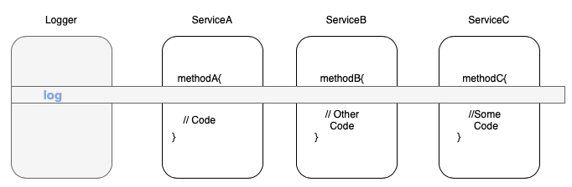
Cross Cutting Concerns

Slide 6
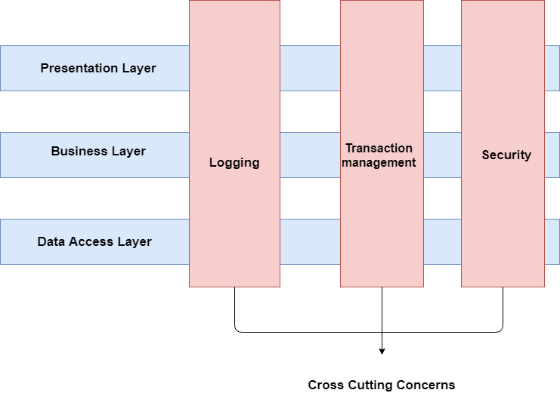
Cross Cutting Concerns
The cross-cutting concerns help in increasing the modularity and separate it from the business logic of an application. Also, a cross-cutting is a concern that affects the whole application and it should be centralized in one location in code as possible such as authentication, transaction management, logging etc.

Slide 7
Spring AOP

Slide 8
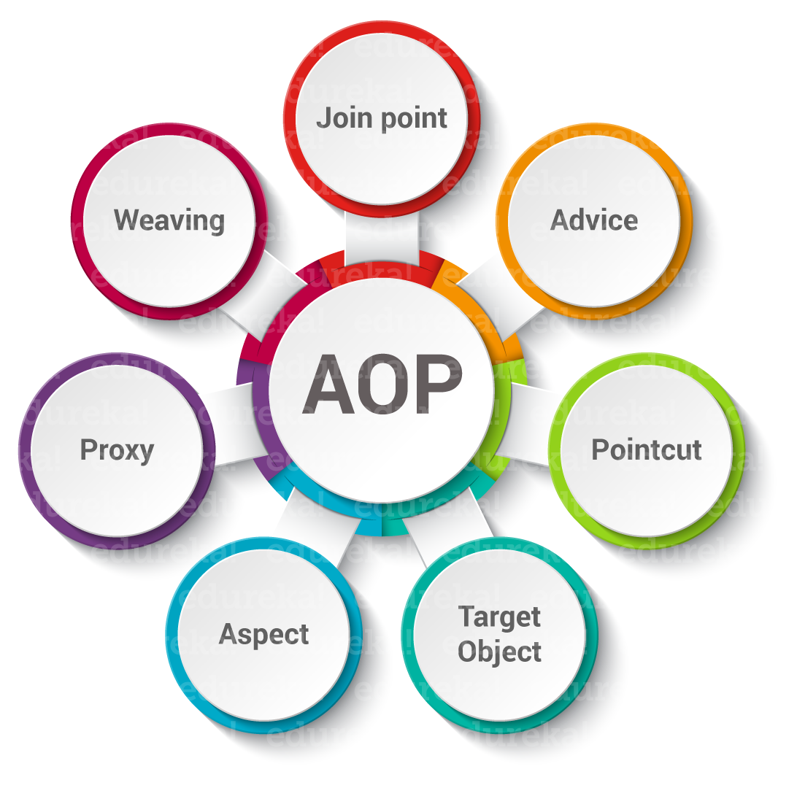
AOP Concepts

Slide 9
AOP Concepts
Aspect: It is a POJO class. It has the logic and the logic is common across modules. @Aspect annotation is generally used to spot an aspect.
Join point: It refers to the point in the app execution where the aspect can be applied. For example we can say the aspect needs to be called when a method invocation happens or an exception is thrown.
Advice : This says when and where an aspect needs to be invoked. There are "around," "before" and "after" advice types. The actual execution of aspect logic happens here. The before advice applies before the joining point.
Point cut: Point cuts are specified using expressions or patterns which say where an aspect is to be executed. Mostly, Advice is accompanied by a Pointcut expression. Also, it runs at any Joinpoint in correspondence with the Pointcut.

Slide 10
AOP Concepts
Target Object: These are the objects on which advices are applied. In Spring AOP, a subclass is created at runtime where the target method is overridden and advices are included based on their configuration.
Proxy: It is an object that is created after applying advice to the target object. In clients perspective, object, the target object, and the proxy object are same.
Weaving: Weaving is the process of linking an aspect with other application types or objects to create an advised object.

Slide 11
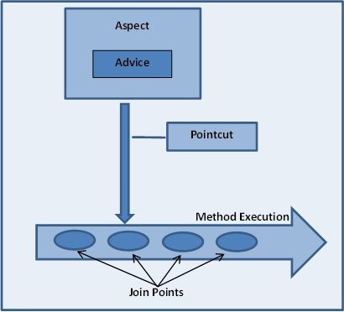
Advice , joinpoint , pointcut
An important term in AOP is advice. It is the action taken by an aspect at a particular join-point.
Joinpoint is a point of execution of the program, such as the execution of a method or the handling of an exception. In Spring AOP, a joinpoint always represents a method execution.
Pointcut is a predicate or expression that matches join points.
Advice is associated with a pointcut expression and runs at any join point matched by the pointcut.
Spring uses the AspectJ pointcut expression language by default.

Slide 12
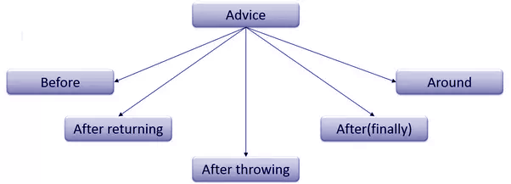
AOP Advice Types
Before: Run the advice before the execution of the method.
After: Run the advice after the execution of a method regardless of the outcome.
After-returning: Run the advice after the execution of the method only after the successful completion of the method.
After-throwing: Run the advice after execution of method only if the method exits throwing an exception.
Around: Run the advice before and after advice method gets invoked.

Slide 13
AOP Advice Types
Before advice: Advice that executes before a join point, but which does not have the ability to prevent execution flow proceeding to the join point (unless it throws an exception).
After returning advice: Advice to be executed after a join point completes normally: for example, if a method returns without throwing an exception.
After throwing advice: Advice to be executed if a method exits by throwing an exception.
After advice: Advice to be executed regardless of the means by which a join point exits (normal or exceptional return).
Around advice: Advice that surrounds a join point such as a method invocation. This is the most powerful kind of advice. Around advice can perform custom behavior before and after the method invocation. It is also responsible for choosing whether to proceed to the join point or to shortcut the advised method execution by returning its own return value or throwing an exception

Slide 14
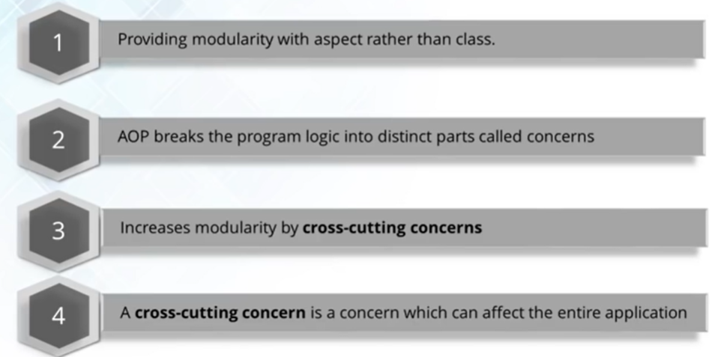
AOP – Aspect Oriented Programming

Slide 15
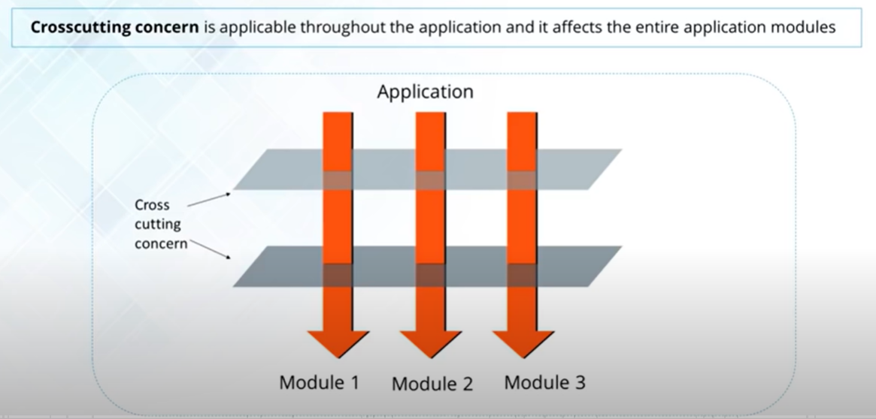
AOP – Aspect Oriented Programming

Slide 16
THANK YOU !!!
AMOL - 9822291613

